Slide 1




Regional energy integration in Europe: the electricity sector
Guido Cervigni

Slide 2
Agenda
Power generation and development
Markets
Transmission network

Slide 3
Agenda
Power generation and development
Markets
Transmission network

Slide 4
Power generation development policies
Objectives
National contributions
Coordination/ Review
National
support mechanisms
Coordination/ Review
• NECPs
• Policies and measures
• Projections and implementation pathway
• Regional
consultation
• Commission recommendations
• ‘Due account or explain’
• Non-binding reconciliation
• EU State aid discipline
• EU climate and energy goals
• EU-wide renewable target
• Renewable schemes
• Capacity remuneration mechanisms for flexible resources
EU institutions set the direction and review the framework
Member States retain broad control over generation choices and support design
Notes:
References:
• EU climate and energy goals: Regulation (EU) 2021/1119 – European Climate Law, Arts. 2(1) and 4. Art. 2(1): EU climate neutrality by 2050. Art. 4(1): at least –55% net GHG emissions by 2030 vs 1990. Art. 4(3), following the 2026 amendment: –90% net GHG emissions by 2040. The latter was introduced by Regulation (EU) 2026/667
• Efficency objectives: Directive (EU) 2023/1791, Art. 4(1): collective EU reduction in energy consumption of at least 11.7% by 2030 relative to the 2020 Reference Scenario.
• EU-wide renewable targets: Directive (EU) 2018/2001 (RED), Art. 3(1), as amended by Directive (EU) 2023/2413.
_________________________________
National contributions: Regulation (EU) 2018/1999 (Governance Regulation), Art. 4(a)(2) and Art. 5, together with RED Art. 3(2). Member States set their national contributions to collectively achieve the EU renewable target
For energy efficiency: Directive (EU) 2023/1791, Art. 4(2) (indicative national energy efficiency contribution).
_________________________________
Coordination / review of national ambition
Regulation (EU) 2018/1999, Arts. 9(2)(a), 13, 14 and 31 (and Art. 34 on Commission recommendations).
Art. 9(2)(a) → Commission assesses draft NECPs specifically regarding the “level of ambition of objectives, targets and contributions”;
Art. 13 → Commission assesses whether national objectives/targets/contributions are collectively sufficient;
Art. 14 → NECP update / iterative process;
Art. 31 → response to insufficient ambition (ambition gap), including recommendations to increase national contributions.
_________________________________
National support mechanisms RED II/III, Art. 4; Regulation (EU) 2019/943, Arts. 19f–19h and 20–22, as amended by Regulation (EU) 2024/1747
_________________________________
EU State aid discipline: TFEU Arts. 107–109; CEEAG 2022; GBER – Reg. (EU) 651/2014, Arts. 41–43; CISAF 2025, Sections 4.1, 4.3–4.4.

Slide 5
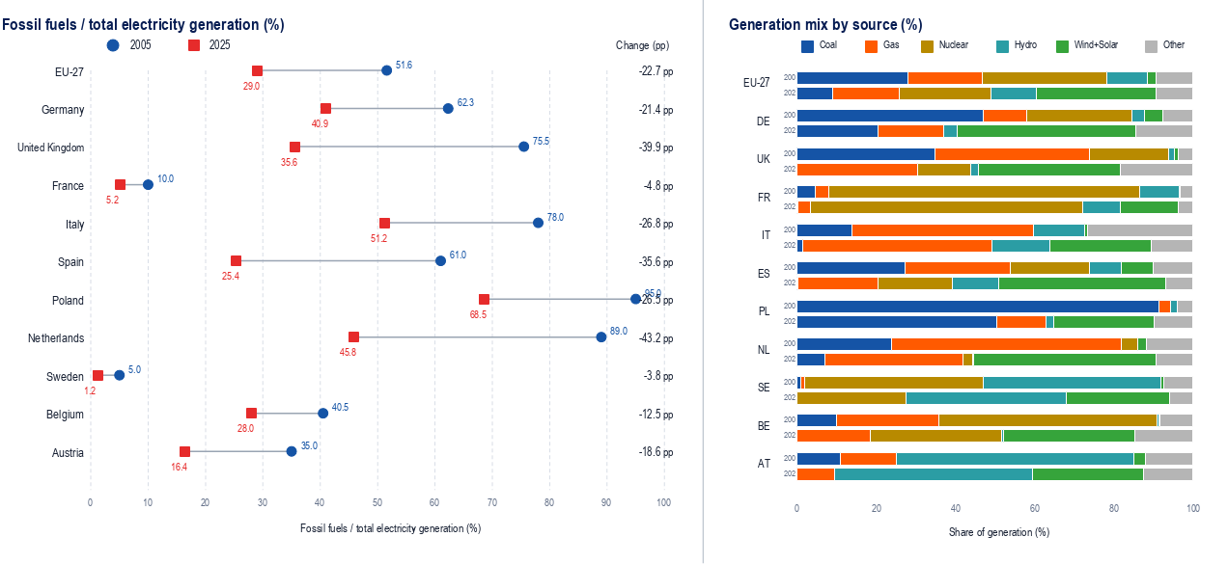
Power generation in Europe: 2005 - 2025
Source: Ember (2026), Our World in Data; DFC Economics analysis.
Strong reduction of fossil-based generation; different national mixes
Notes:
References:
Ember (2026), Yearly Electricity Data Europe, via Our World in Data (OWID).
Primary dataset: https://ember-energy.org/data/yearly-electricity-data/
Machine-readable release: https://files.ember-energy.org/public-downloads/europe_yearly_full_release_long_format.csv
OWID electricity mix dataset: https://ourworldindata.org/grapher/electricity-mix
Fossil-fuel share: OWID/Ember, “Share of electricity generation from fossil fuels”.
Fossil fuels include coal, natural gas and oil/other fossil fuels.
Coal, gas, nuclear and hydro shares are taken from the corresponding OWID/Ember series.
Wind & Solar is calculated as the sum of OWID wind and solar generation shares.
“Other” is calculated by DFC Economics as the residual to 100%.
It therefore includes bioenergy, oil/other fossil fuels, geothermal and other minor sources.
2005 historical values were cross-checked against Eurostat/European historical generation statistics.
EU-27 2025 values were cross-checked against Ember, European Electricity Review 2026.
Figures refer to domestic electricity generation; imports are not included in the generation shares

Slide 6
Agenda
Power generation and development
Markets
Transmission network

Slide 7

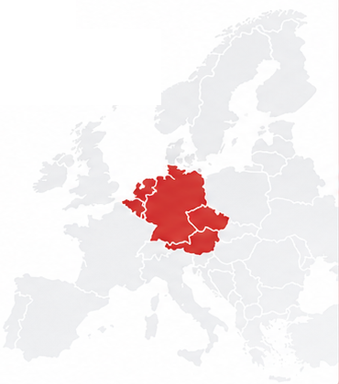
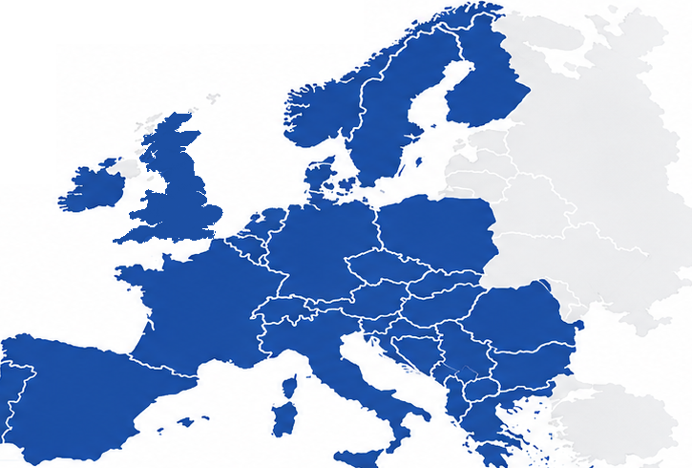
Electricity forward trading
Delivery locations
2005
2025
Market share: 70%-100%
Volume 2025: 9.33 PWh
(EU&GB demand 3.09 PWh)
Forward horizon: Cal+10y
Yearly products dominate trading
Forward trading has become pan-European, with one dominant marketplace
Notes:
Market share (selected markets)
DE 70% • FR 91% • IT 88% • ES 94% • NL 96% • HU 100%

Slide 8
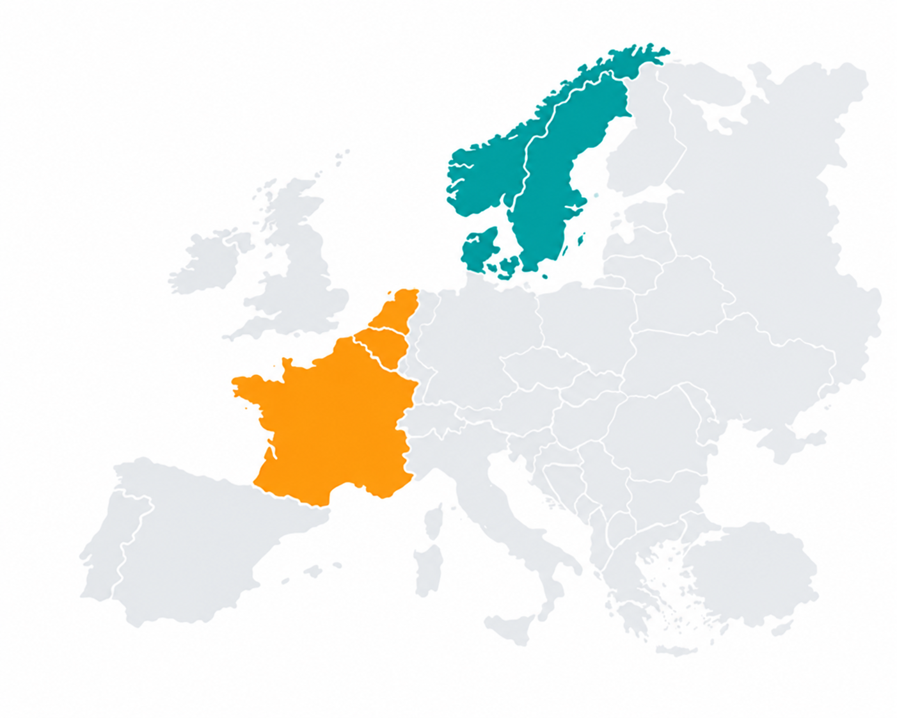
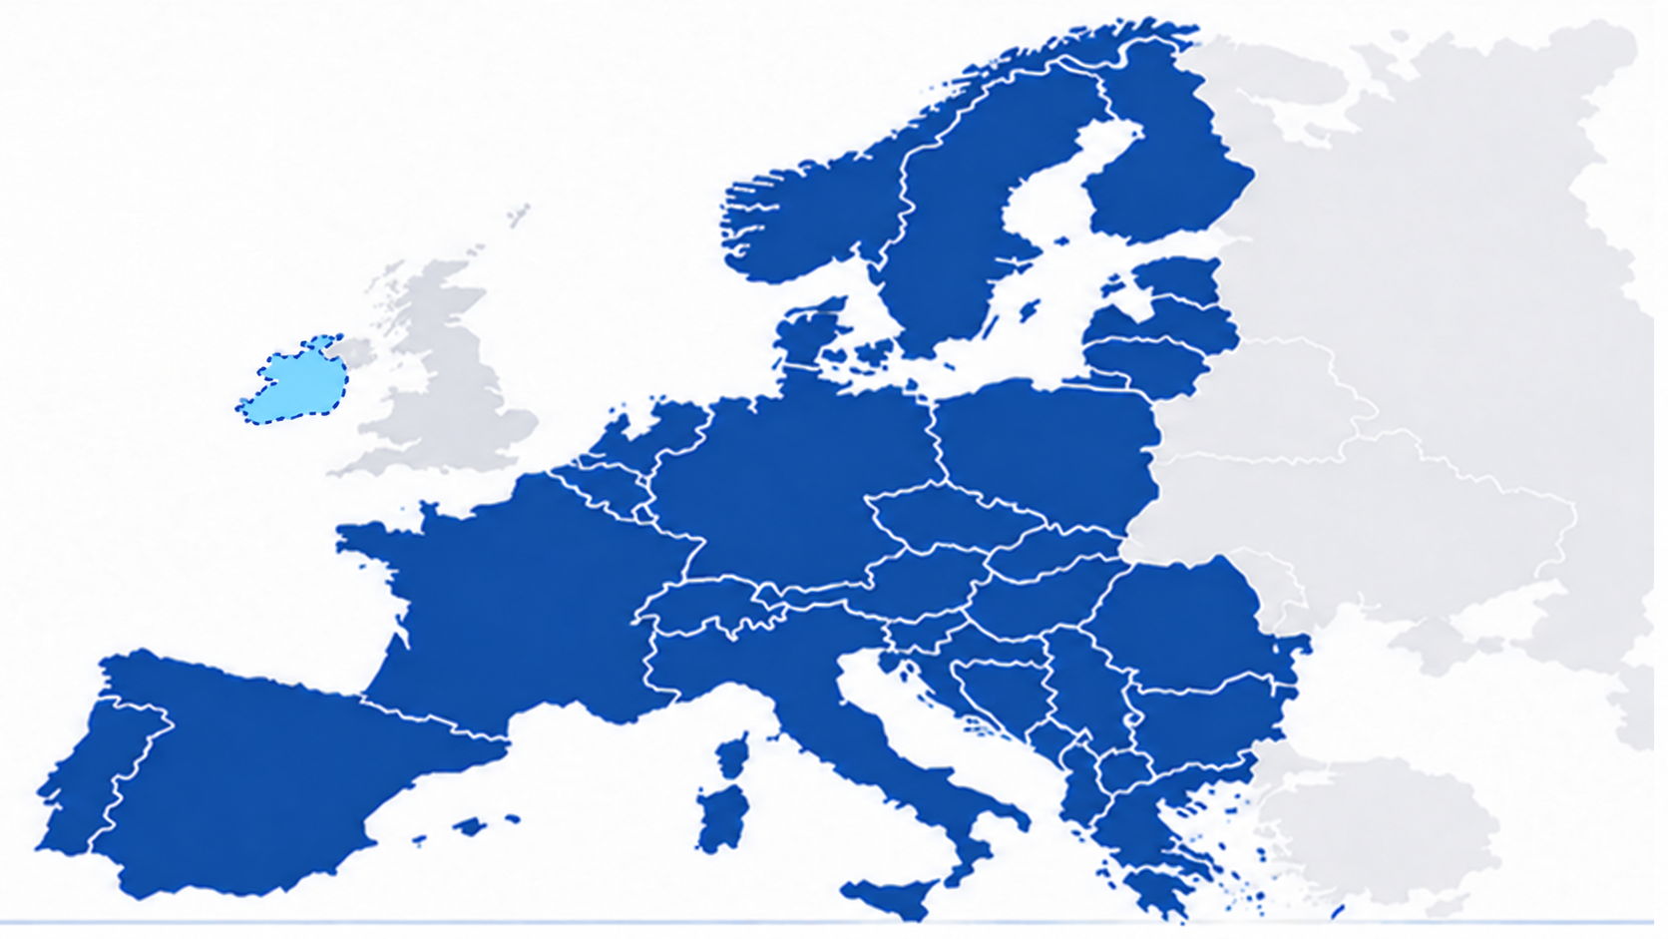
Electricity spot trading
MCSC
Market coupling footprint
2006
2025
Market Coupling Steering Committee
17 NEMOs & 30 TSOs
5 core agreements,
10+ supporting contracts, operational procedures
Volume 2025
SDAC 1.90 PWh
SIDC 0.387 PWh
(EU power demand 2.8 PWh)
Sources: NEMO Committee; ENTSO-E / MCSC; CACM Annual Report 2025.
From regional clusters to single day-ahead and intraday market coupling, with implicit transmission capacity allocation
Notes:
DAOA — Day-Ahead Operations Agreement
ANDOA — All NEMO Day-Ahead Operations Agreement
IDOA — Intraday Operations Agreement
ANIDOA — All NEMO Intraday Operations Agreement
TCMC — TSO Cooperation Agreement for Market Coupling

Slide 9
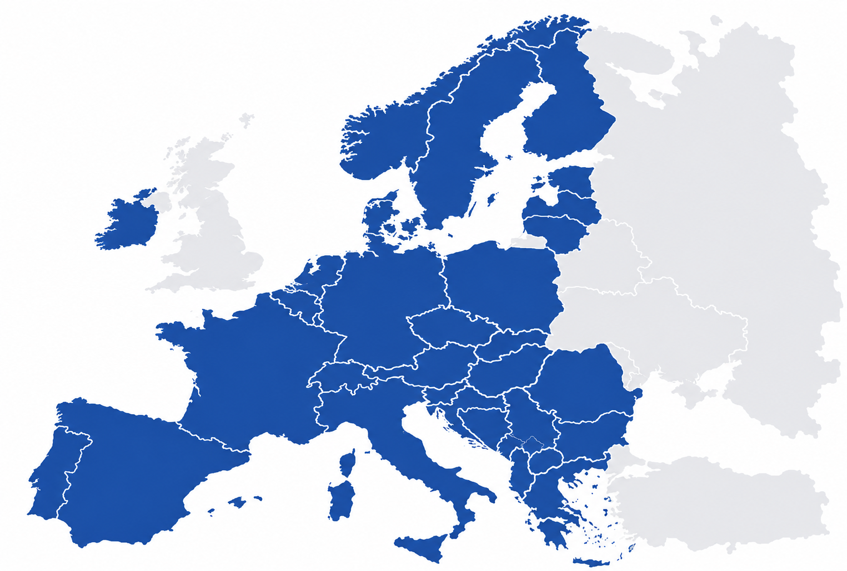
Ancillary services and balancing
FI
NO
FCR Cooperation (9)
SE
Frequency Containment Reserve
EE
PICASSO (aFRR) (17)
LV
Automatic Frequency Restoration Reserve
DK*
MARI (mFRR) (26)
LT
Manual Frequency Restoration Reserve
NL
DE
PL
TERRE (RR, legacy)* (8)
Replacement Reserves - decommissioned
BE
IGCC (18 / 24)
CZ
LU
SK
RO
Imbalance Netting & counter-activation
HU
FR
CH
AT
PT
BG
SI
ES
IT
HR
GR
Increasing integration of real-time procurement, with challenging interactions with national mechanisms
Notes:
References:
ENTSO-E, Electricity Balancing – Implementation Projects, overview of the European balancing platforms: PICASSO (aFRR), MARI (mFRR), TERRE (RR), IGCC (imbalance netting) and FCR Cooperation.
ENTSO-E Electricity Balancing overview
ENTSO-E, PICASSO – Platform for the International Coordination of Automated Frequency Restoration and Stable System Operation, European platform for the exchange of balancing energy from automatic Frequency Restoration Reserves (aFRR), established pursuant to Art. 21 of Regulation (EU) 2017/2195.
ENTSO-E PICASSO
ENTSO-E, MARI – Manually Activated Reserves Initiative, European platform for the exchange of balancing energy from manual Frequency Restoration Reserves (mFRR).
ENTSO-E MARI
ENTSO-E, TERRE – Trans European Replacement Reserves Exchange, European platform for Replacement Reserves (RR) under Art. 19 of the Electricity Balancing Guideline. Note that TERRE/LIBRA ceased operations in December 2025 and was decommissioned in March 2026; therefore, if our slide depicts the current 2026 architecture, we should label TERRE as a former platform rather than an active one.
ENTSO-E TERRE
ENTSO-E, FCR Cooperation, common market for the procurement and exchange of Frequency Containment Reserves (FCR). ENTSO-E currently describes the cooperation as covering the Austrian, Belgian, Czech, Danish, Dutch, French, German, Slovenian and Swiss TSOs.
ENTSO-E FCR Cooperation
European Commission, Commission Regulation (EU) 2017/2195 of 23 November 2017 establishing a guideline on electricity balancing (EB GL) — core legal framework for European balancing-market integration and the establishment of common platforms for FRR and RR.
Regulation (EU) 2017/2195 – EUR-Lex
ENTSO-E, “Go-Live of PICASSO and MARI platforms…” (2 December 2022) — useful source for the overall narrative that MARI and PICASSO, together with TERRE and IGCC, implemented the European target model for balancing-market integration.
ENTSO-E, Electricity Balancing Report / Market Report 2026 — useful as the latest status source for participation/accession to MARI and PICASSO and developments during 2025–26.

Slide 10
Agenda
Power generation and development
Markets
Transmission network

Slide 11
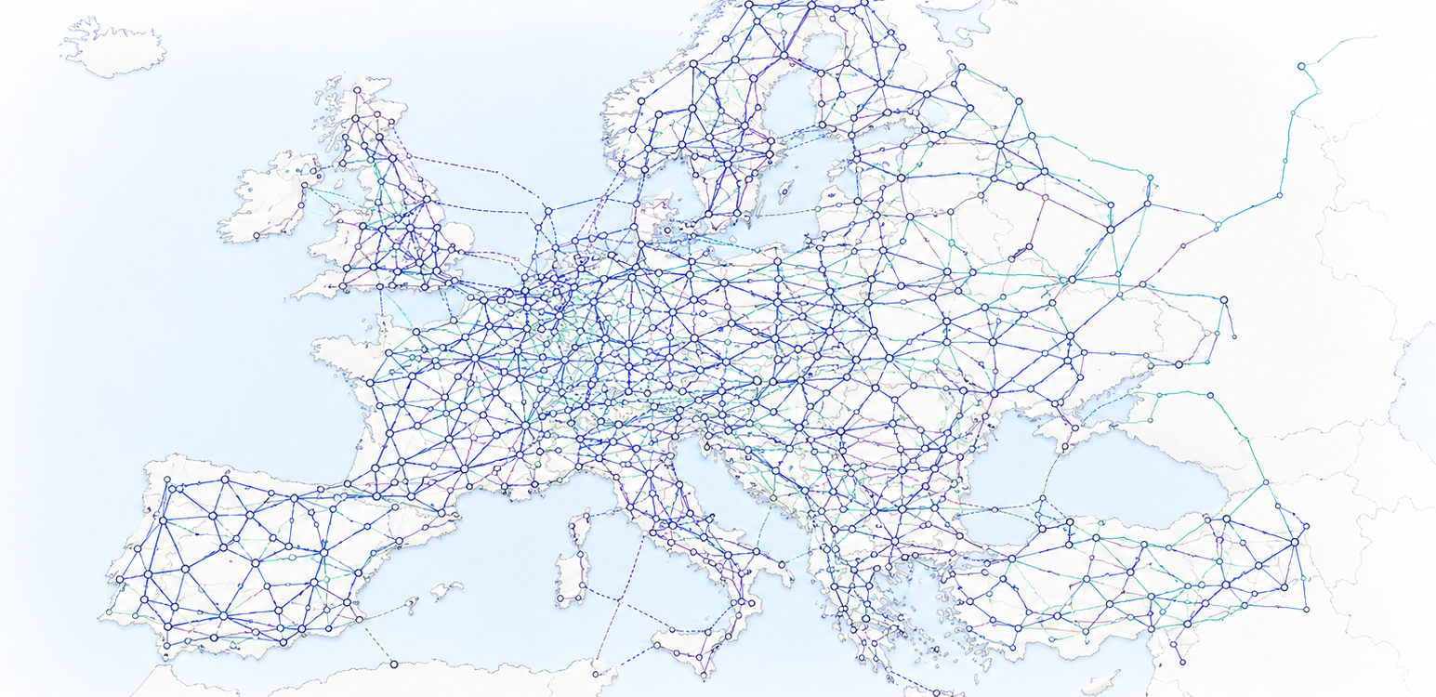
The European transmission network
Source: ENTSO-E, Transmission System Map / Grid Map (2024);
A highly meshed system, with dense cross-border interconnections
Notes:
Coexistence with national mechanisms ...

Slide 12
Cross-border grid projects: PCI decision chain
EU / supranational
Member States
Project promoters
NRAs
1. Policy &
planning inputs
2. Joint scenarios
& system needs
3. Project origination
& TYNDP application
4. TYNDP admission
& project CBA
5. PCI application
& regional selection
6. Investment request or exemption
7. National approvals
& delivery
• EU climate & energy objectives
• NECPs + national grid plans
• Inputs to joint scenarios
• ENTSO-E / ENTSOG joint scenarios
• Infrastructure Gaps Report
• Need identified ≠ project
• Promoter develops project concept
• Submission via ENTSO-E call
• Administrative / technical criteria
• Project enters TYNDP portfolio
• ENTSO-E project assessment
• Cross-border benefits quantified
• TYNDP inclusion is prerequisite
• Application to Regional Group
• ACER opinion → Union list
• Mature PCI → investment request or exemption
• NRAs decide cost allocation
• CEF support subject to conditions
• PCI enters national / regional plans
• Permitting + tariff recognition
• Construction / commissioning
A complex, multi-stage process involving a wide range of EU, national
and sector institutions
Notes:
References – PCI decision chain
1. Policy and planning inputs
Regulation (EU) 2019/943 on the internal market for electricity, Art. 30(1)(b) and Art. 48: ENTSO-E prepares the biennial Union-wide TYNDP, building on national investment plans and regional investment plans.
Regulation (EU) 2018/1999 on the Governance of the Energy Union: National Energy and Climate Plans (NECPs) provide national policy, demand, generation and decarbonisation assumptions feeding EU infrastructure planning.
2. Joint scenarios and system needs
Regulation (EU) 2022/869 (TEN-E), Art. 12: ENTSO-E and ENTSOG develop joint scenarios for the TYNDP process, subject to stakeholder consultation, ACER opinion and Commission approval.
Regulation (EU) 2022/869, Art. 13: ENTSO-E/ENTSOG identify infrastructure gaps on the basis of those scenarios, including cross-border network needs and alternatives to new infrastructure.
3. Project origination and application to TYNDP
ENTSO-E, TYNDP 2026 Guidance for Applicants – Criteria for applications and their treatment, Section 2: project promoters submit transmission/storage projects and must satisfy defined administrative and technical eligibility criteria.
ENTSO-E, Include your project in TYNDP 2026, 24 April 2025: applications are submitted through the TYNDP Projects Platform; inclusion in TYNDP is a prerequisite for transmission/storage projects subsequently applying for PCI/PMI status.
4. TYNDP admission and project CBA
ENTSO-E verifies submitted projects against the administrative and technical admission criteria; compliant projects enter the TYNDP Project Portfolio and subsequently undergo project-level cost-benefit assessment.
Regulation (EU) 2022/869, Art. 11 and Annex V: framework for the harmonised energy-system-wide cost-benefit analysis used to assess infrastructure projects.
5. PCI application and regional / EU selection
Regulation (EU) 2022/869, Annex III, Section 2(3): proposed electricity transmission and storage PCIs must be included in the latest available Union-wide TYNDP.
Regulation (EU) 2022/869, Arts. 3–4 and Annex III: Regional Groups assess candidate projects against the PCI criteria and establish regional lists; the Commission adopts the Union List, taking account of Regional Group deliberations and ACER opinions.
6. Cross-border cost allocation and financing
Regulation (EU) 2022/869, Art. 16: project promoters may submit an investment request including project-specific CBA, business plan and a request for cross-border cost allocation; the relevant NRAs decide jointly, with ACER deciding where they cannot agree.
Regulation (EU) 2022/869, Arts. 17–18: regulatory incentives for higher-risk PCI investments and eligibility, subject to the applicable conditions, for Union financial assistance under the Connecting Europe Facility.
7. National approvals, permitting and delivery
Regulation (EU) 2022/869, Arts. 8–10: national competent authorities coordinate and accelerate PCI permit-granting; the process comprises a pre-application procedure and a statutory permit-granting procedure, with an overall target duration of no more than 42 months, subject to permitted extensions.
Regulation (EU) 2022/869, Art. 3(6): electricity PCIs become an integral part of the relevant regional investment plans and national ten-year network development plans and receive the highest possible priority in those plans.
Main legal sources: Regulation (EU) 2022/869 (revised TEN-E Regulation); Regulation (EU) 2019/943 on the internal market for electricity; Regulation (EU) 2018/1999 on the Governance of the Energy Union; ENTSO-E TYNDP 2026 Guidance for Applicants.

Slide 13
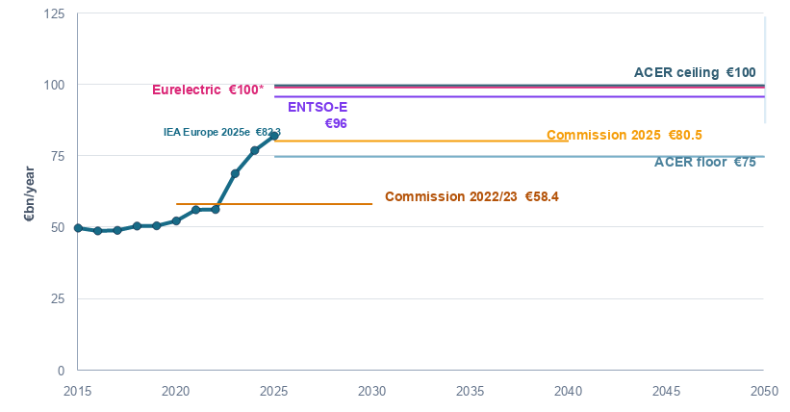
Transmission and distribution investment (€bn/year)
Historical values converted from constant 2024 USD;
2025 is an IEA estimate
“Current investments in cross-border energy infrastructure are clearly insufficient [...] About half of cross-border electricity needs for 2030 (41 of 88 GW) will remain unaddressed” European Commission, COM(2025) 1006 final, Explanatory Memorandum, Section 1, p. 2
Notes:
References
1. Historical network investment – IEA
IEA (2025), World Energy Investment 2025 Datafile, Europe sheet, category “Electricity networks”. The series used in the slide covers transmission + distribution investment for Europe over 2015–2025; 2025 is an IEA estimate. Values are reported by IEA in constant 2024 USD.
https://www.iea.org/data-and-statistics/data-product/world-energy-investment-2025-datafile
IEA (2025), World Energy Investment 2025 – How we track investment in energy: methodology and price-basis definitions.
https://www.iea.org/reports/world-energy-investment-2025/how-we-track-investment-in-energy
The IEA “Europe” perimeter is broader than the EU: it includes the EU, UK and additional neighbouring European economies included in the IEA regional aggregate.
2. Conversion of historical IEA values into EUR
IEA historical values are converted from constant 2024 USD into EUR using the ECB 2024 annual-average USD/EUR reference rate: EUR 1 = USD 1.0824. Conversion used in the slide: EUR bn = USD bn / 1.0824.
ECB, annual USD/EUR reference-rate series:
https://data.ecb.europa.eu/data/datasets/EXR/EXR.A.USD.EUR.SP00.A
3. ACER 2025–2050 investment-needs range
ACER (2024), Competitive and sustainable electric grid development, Figure 6 and Table A1. ACER normalises estimates from ERT, Ember, ENTSO-E and Eurelectric to provide comparable EU transmission + distribution investment requirements for 2025–2050.
https://www.acer.europa.eu/sites/default/files/documents/Publications/ACER_2024_Monitoring_Electricity_Infrastructure.pdf
The range used in the slide is approximately EUR 75–100bn/year, corresponding to total investment of approximately EUR 1.95–2.60tn over 2025–2050.
4. ENTSO-E benchmark
The ENTSO-E estimate shown in the slide is the ACER-normalised value reported in Figure 6 / Table A1, approximately EUR 96bn/year over 2025–2050. It should therefore be cited through the ACER comparison rather than treated as a separately recalculated DFC estimate.
Source: ACER (2024), Competitive and sustainable electric grid development, Figure 6 / Table A1.
5. Eurelectric benchmark
The Eurelectric estimate shown in the slide is likewise the ACER-normalised value, approximately EUR 100bn/year over 2025–2050.
Source: ACER (2024), Competitive and sustainable electric grid development, Figure 6 / Table A1.
For graphical readability only, the Eurelectric line may be plotted at EUR 99.3bn/year so that it does not overlap exactly with the EUR 100bn/year upper bound; the label and underlying value remain EUR 100bn/year.
6. European Commission – earlier estimate (2022/23)
European Commission, COM(2023) 757 final, Grids, the missing link – An EU Action Plan for Grids. The Commission refers to approximately EUR 584bn of electricity-grid investment for 2020–2030.
https://eur-lex.europa.eu/legal-content/EN/TXT/?uri=COM:2023:757:FIN
For comparability with the annual figures in the slide, DFC annualises this total as EUR 58.4bn/year.
7. European Commission – 2025 estimate
European Commission, guidance of 2 June 2025 on anticipatory investments for electricity grids. The Commission indicates investment needs by 2040 of approximately EUR 730bn for distribution networks + EUR 477bn for transmission networks = EUR 1,207bn.
https://energy.ec.europa.eu/news/eu-guidance-ensuring-electricity-grids-are-fit-future-2025-06-02_en
The slide annualises EUR 1,207bn over 2025–2040, giving approximately EUR 80.5bn/year.
Methodological note / comparability
The historical IEA series and the forward-looking benchmarks are not perfectly like-for-like geographically. IEA historical “Europe” is broader than the EU and includes the UK and other neighbouring economies, whereas the ACER and Commission forward-looking estimates refer to the EU.

Slide 14
Thank you for your attention
Guido Cervigni
Managing Director
DFC Economics S.r.l.
www.dfc-economics.com
Email: guido.cervigni@dfc-economics.com
Tel.: +393483260451

Slide 15
Backup: what lessons from Europe to developing countries?

Slide 16
The EU experience is one of success in multiple areas, but the resulting institutional complexity reflects Europe’s own history. Developing regions may benefit more from adopting the principles than replicating the architecture.
Integration was built from already mature national systems. Europe started from developed power systems, established utilities, well developed national governance frameworks. Because integration had to preserve national prerogatives and accommodate many existing arrangements, the resulting design reflects multi-dimensional negotiations. The result is a framework that is inclusive and politically durable, but also complex. Where countries are building regional cooperation from an earlier stage, there may be scope for simpler arrangements.
Highly meshed networks make “merchant-like” logic difficult to apply. Because of large network externalities, the bilateral commercial logic is an imperfect basis for investment decisions and financing, while explicit cross-border cost allocation may be politically difficult.
Generation and retail liberalisation separate network investment from the commercial decisions that create its value. This makes it harder to hedge network investment through long-term commercial commitments and creates a risk of uncoordinated decisions or timing mismatch.
Europe could afford gradual integration and repeated institutional layering. Developing regions may face more urgent electrification needs, making a simpler architecture with clearer decision rights and faster project delivery more valuable.
Financing conditions. European network investment is supported by relatively deep capital markets, public financing institutions and generally credible tariff recovery. In developing systems, financing constraints may be more binding, also on the selection of governance arrangements.

